Slide 1

gear behavior
clues to reducing whale entanglement risk
Pete Nelson
marine ecology

Slide 2
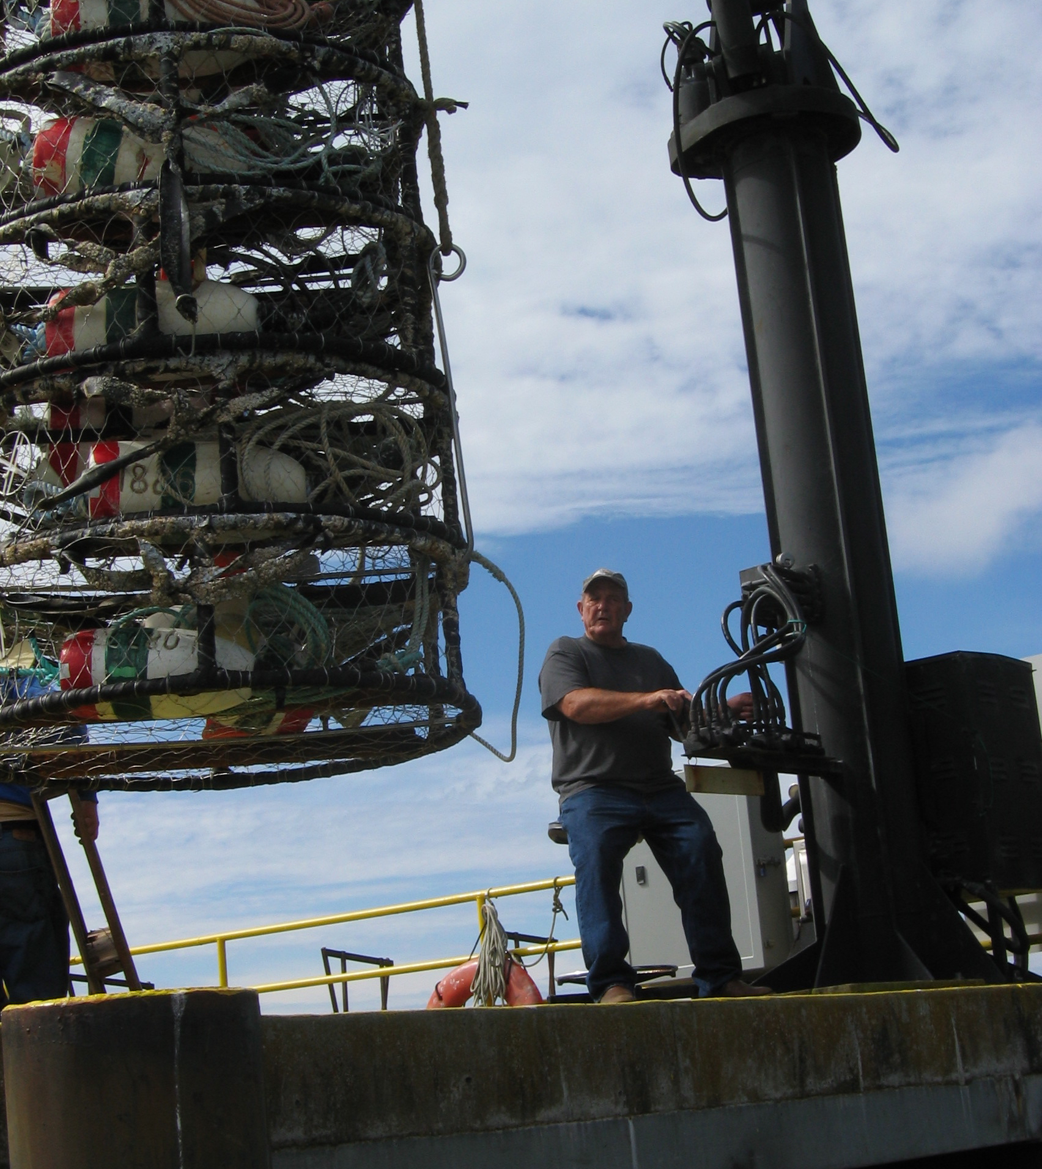
How does crab gear behave under different conditions?
line profiles
line tension
visual characteristics
gear configurations

Slide 3
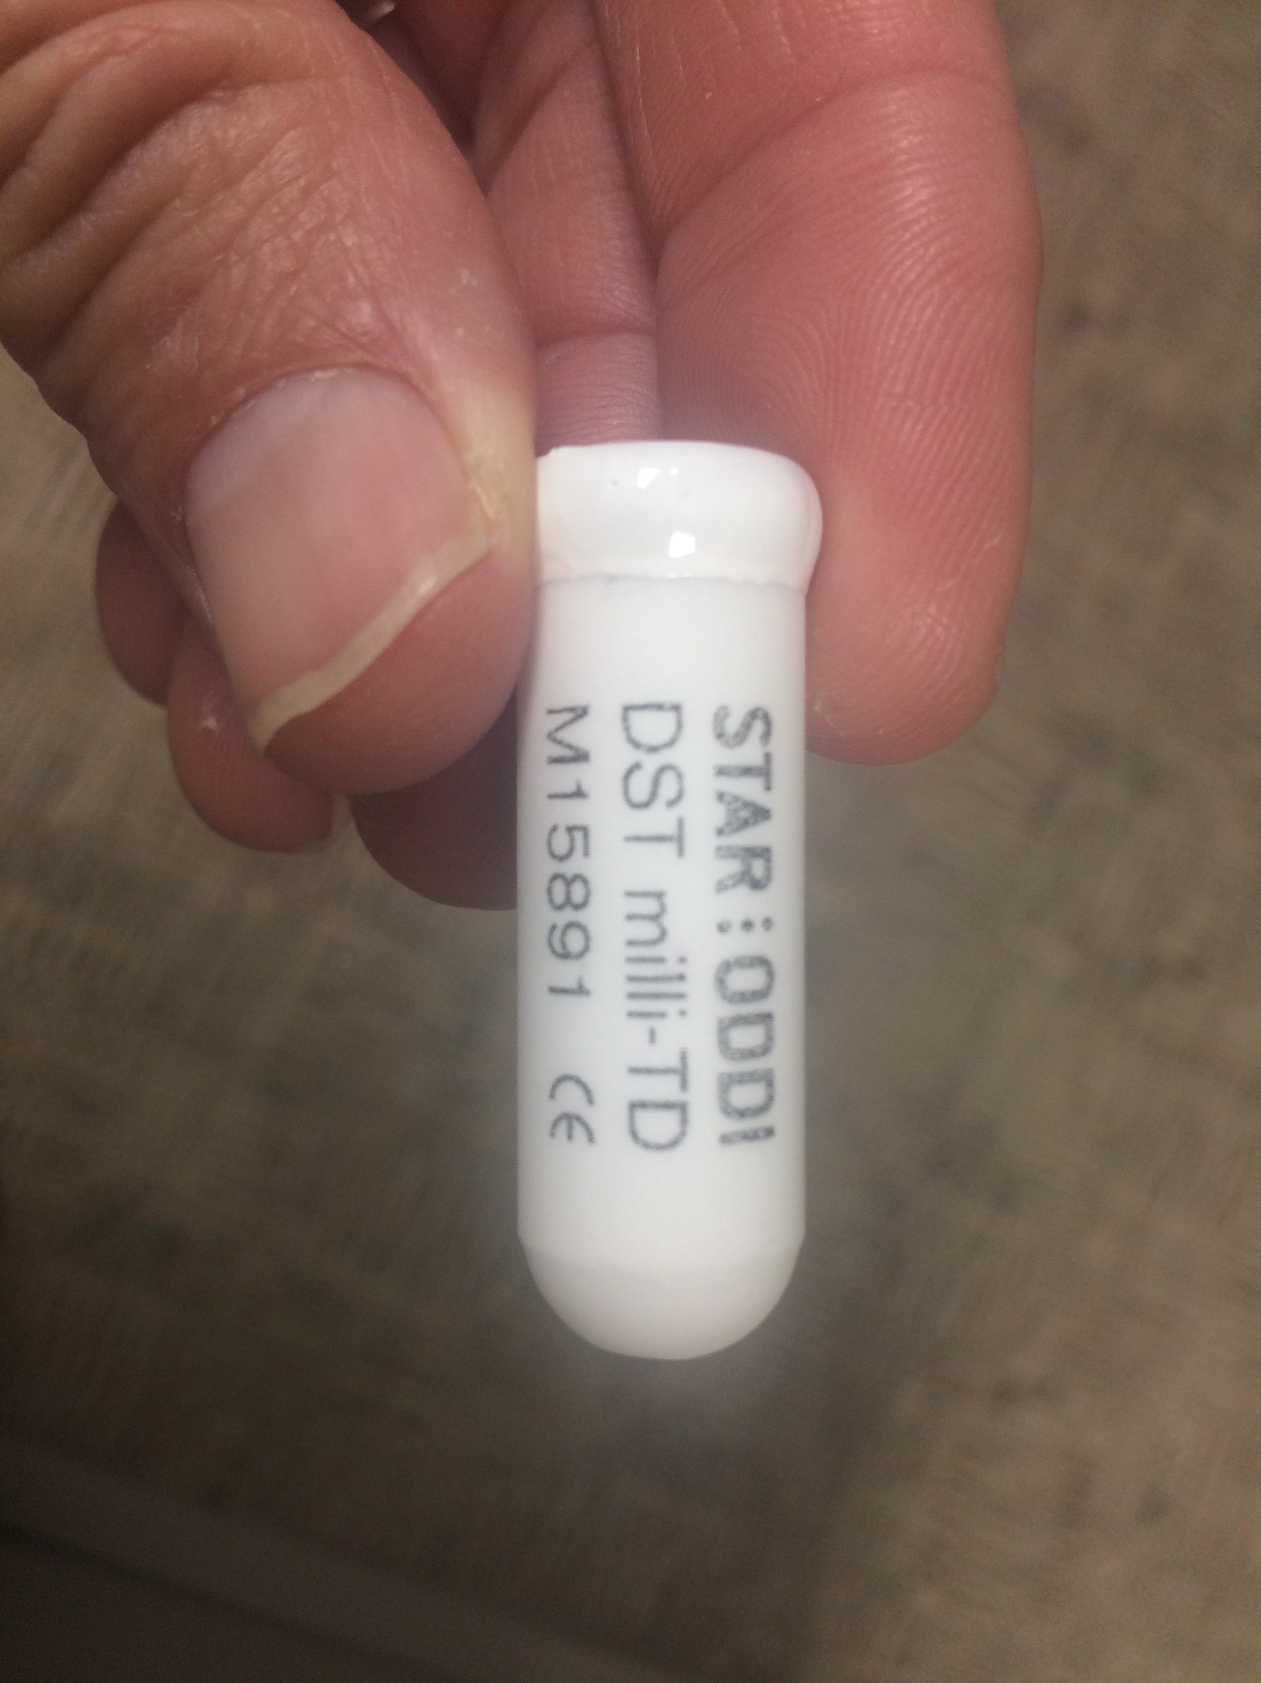

Slide 8
Feb 13, 13:41:00 (31.6 fathoms)
Feb 15, 10:52:20 (31.8 fathoms)
Notes:
1137 meters distance between, both set at or near high water

Slide 9
Feb 13, 13:41:00
Feb 15, 10:52:20

Slide 12
February 14, 20:30
February 15, 07:50
February 15, 20:18
low: 0.36 m
February 16, 08:20
Notes:
low of 0.19 m Feb 14 at 19:39
low of 0.47 m Feb 15 at 08:23
low of 0.46 m Feb 16 at 09:19

Slide 13
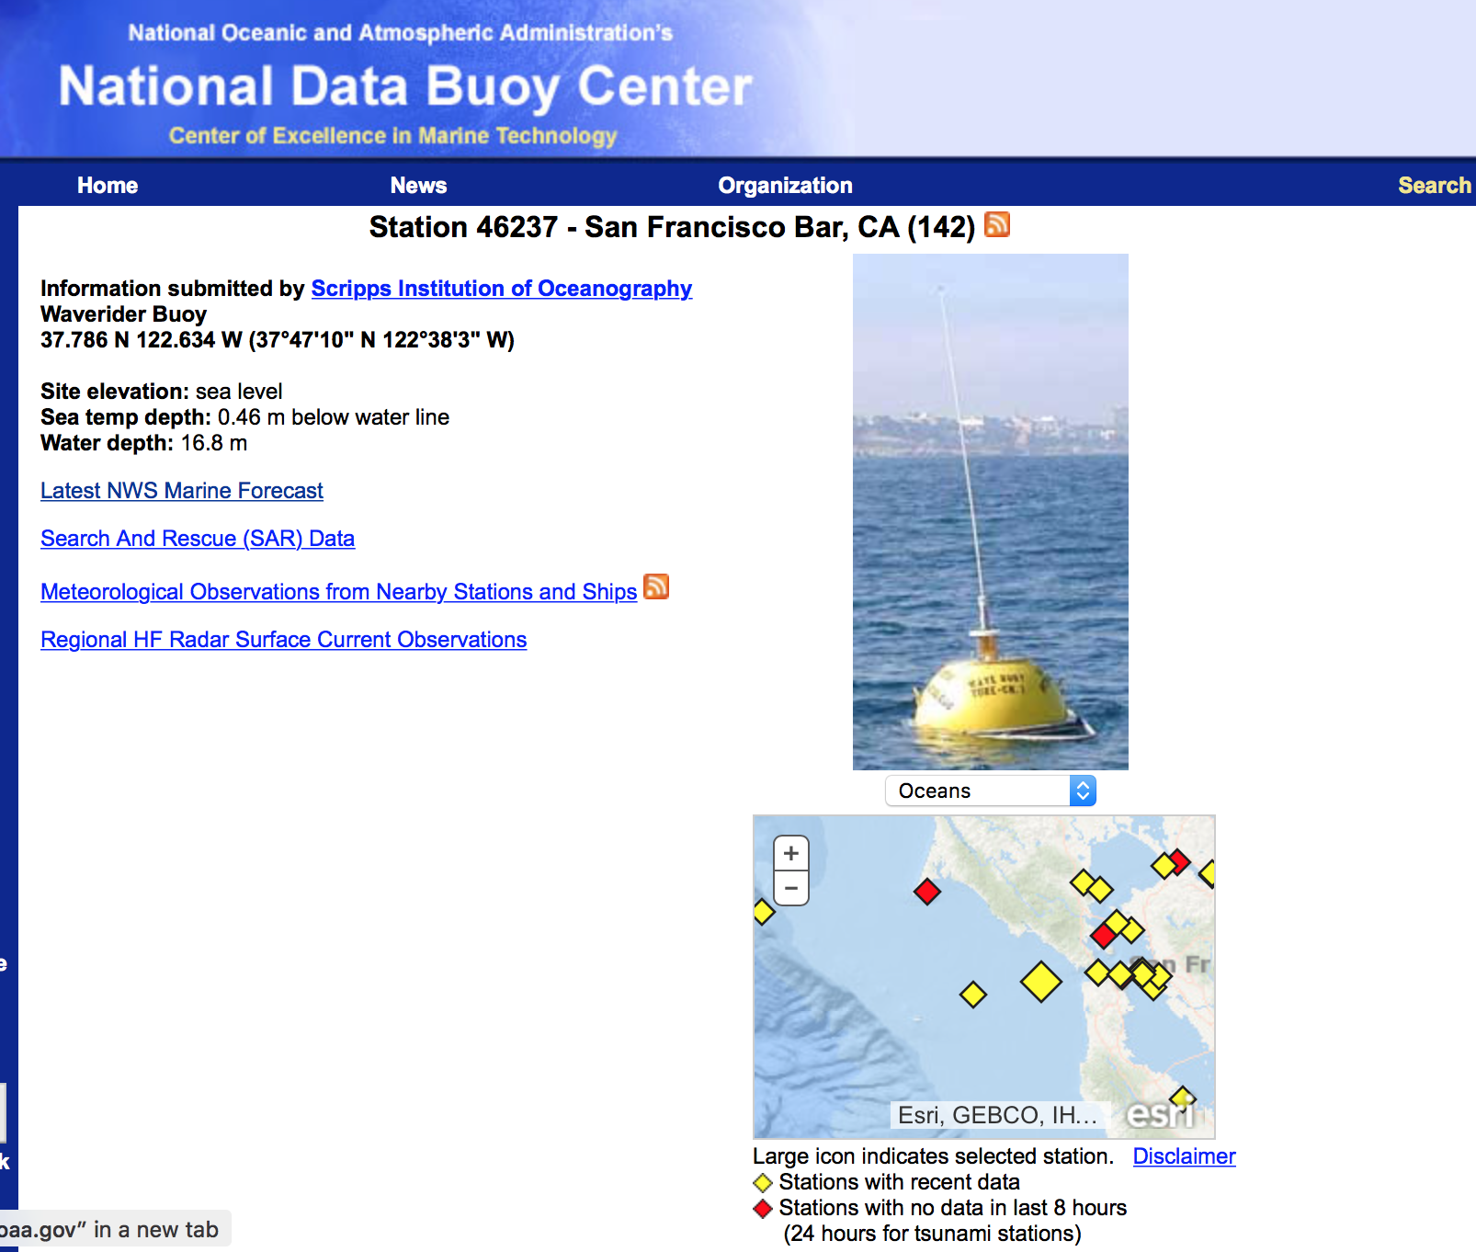
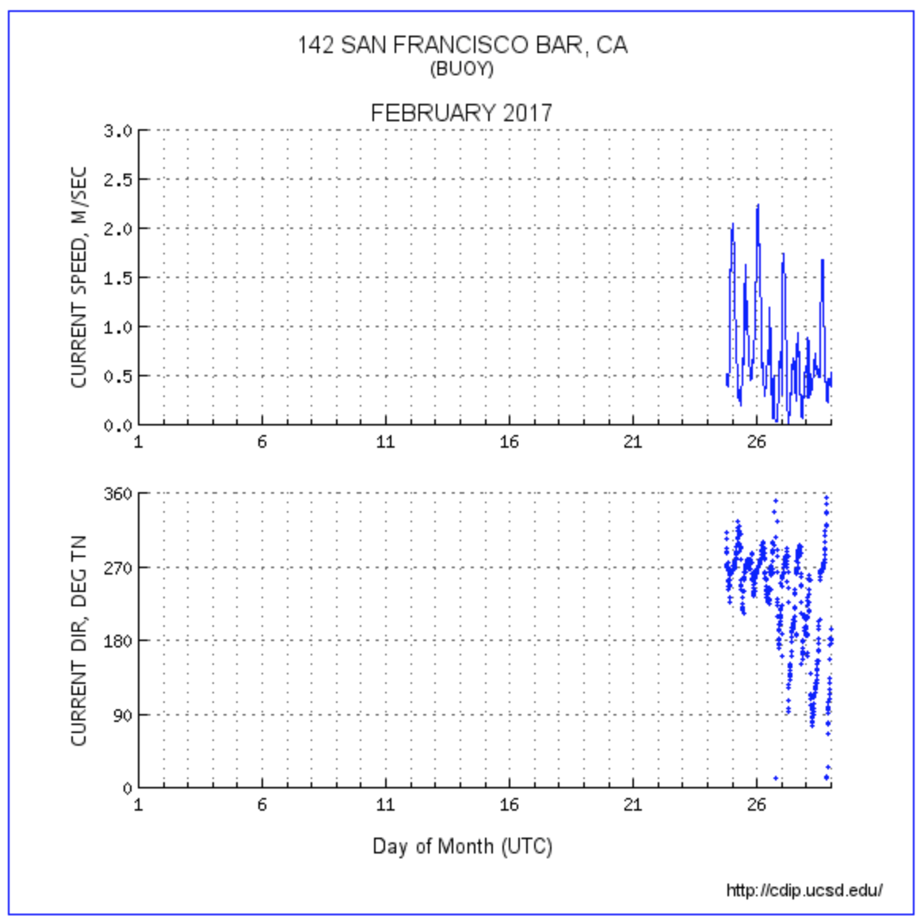

Slide 14
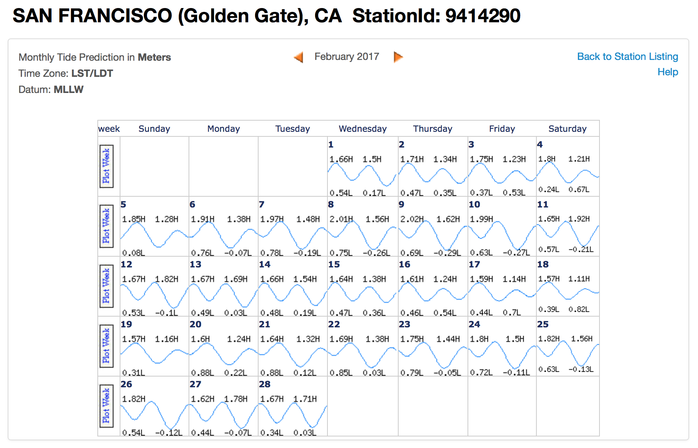
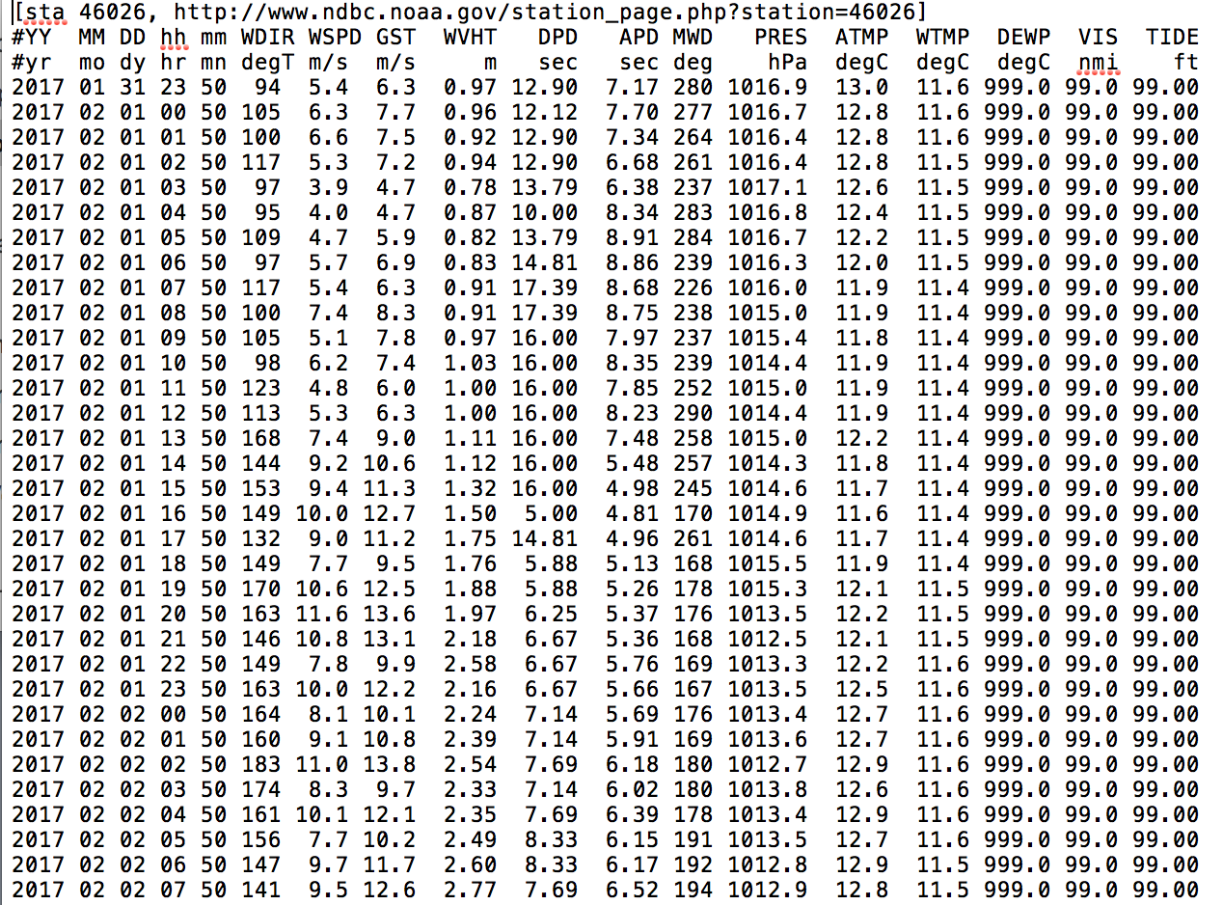

Slide 15
orange top
blue top
splice
splice
blue bottom
blue bottom

Slide 16
neutral (orange) top shot

Slide 17
splice joining (neutral to floating) shots

Slide 18
floating (blue) bottom shot

Slide 19
floating (blue) top shot

Slide 20
splice joining (floating to floating) shots

Slide 21
floating (blue) bottom shot

Slide 22
February 18, 22:10
February 16, 07:10
Notes:
Feb 18 23:02 low of 0.82 meters

Slide 23
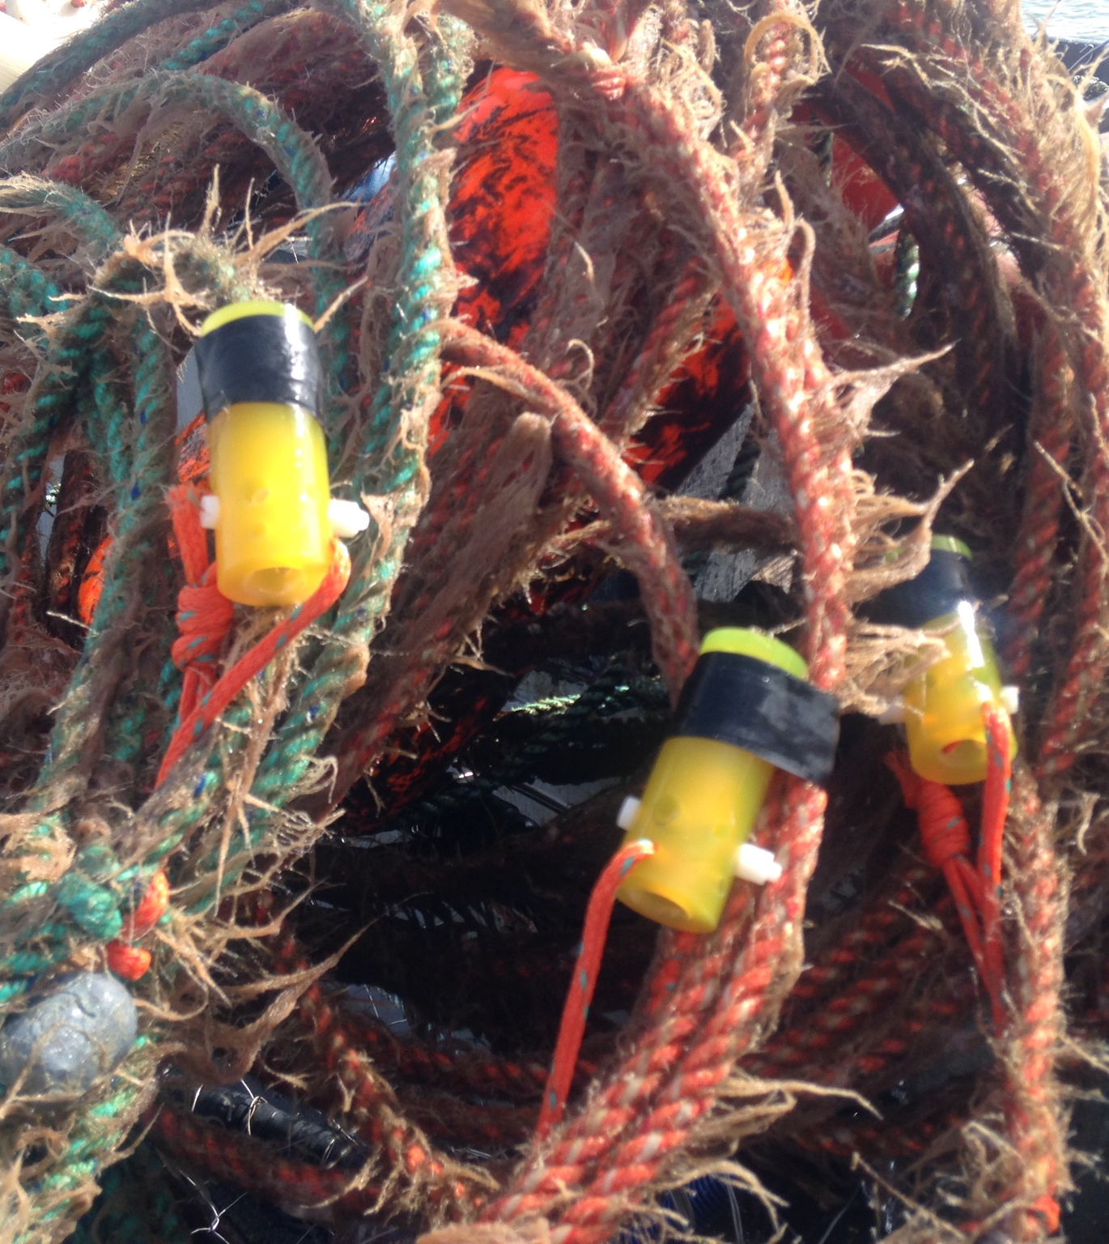
line profile questions
What ocean conditions predict line profiles?
What are the effects of different gear configurations?
How is line profile correlated with line tension?
Notes:
current velocity, sea state, tidal cycles, wind(?)
scope, line density, leads

